Slide 1


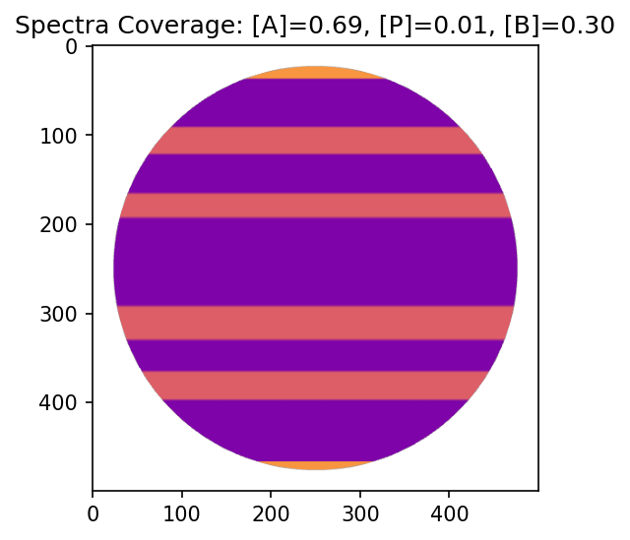
A
Photometric prediction
B
Polar region not visible, small polar flux
Polar region visible, large polar flux
i = 0°
i = 20°
i = 20°
Spectrophotometric prediction
C
i = 0°
i = 20°
E
D
Final Spectra
Band Spectra
Polar Spectra
Spectral Lookup Map
Spectral Lookup Map

Slide 2
A
Photometric prediction
B
Polar region not visible
Polar region visible
i = 0°
i = 20°
i = 20°
Polar region not visible
Polar region visible
Spectrophotometric prediction
E
C
i = 0°
i = 20°
pole
band
D
band
band
Band Spectra
Total Spectra
Polar Spectra
band
band

Slide 3
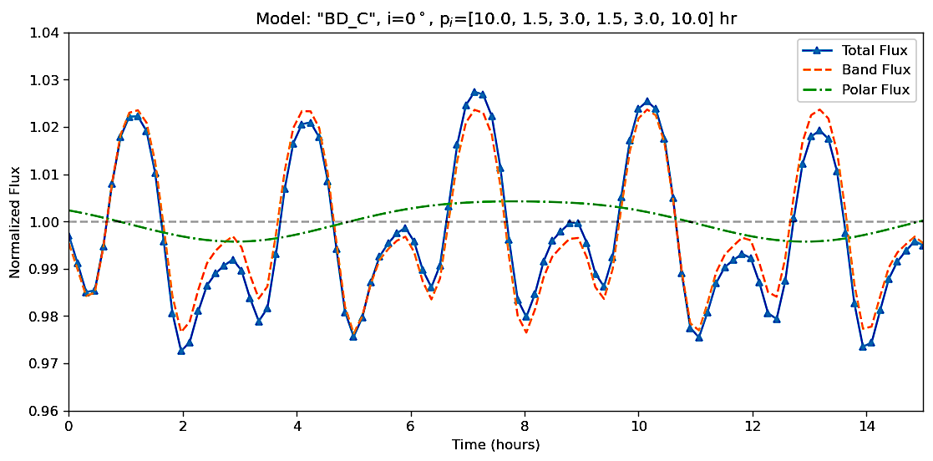
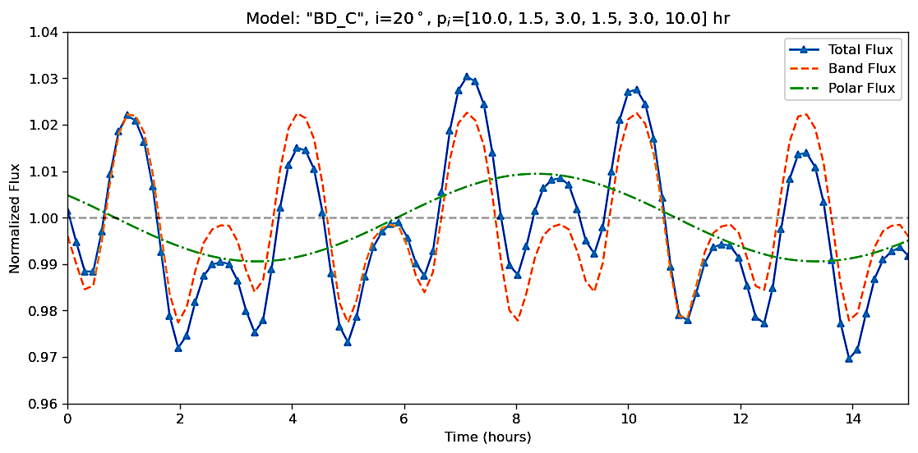
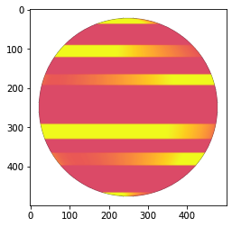
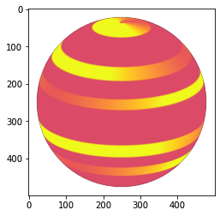
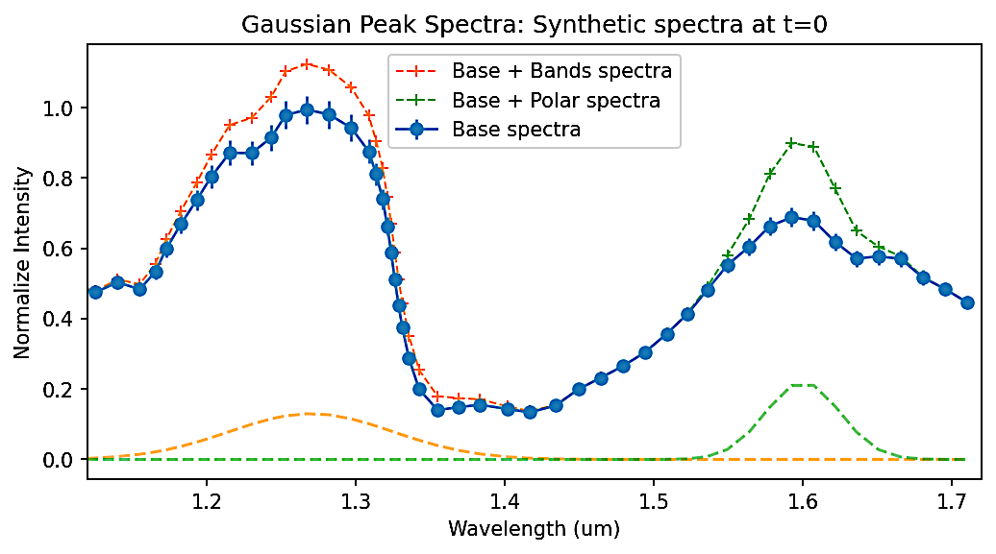
Photometry
Polar region not visible, small polar flux
Polar region visible, large polar flux
A
B
i = 0°
i = 20°
Spectroscopy
C
i = 0°
D
i = 20°
E
Band Spectra
Polar Spectra
Spectral Lookup Map
Spectral Lookup Map

Slide 4











